Slide 1

GROUP 7 – INFLATION in 3 CONSUMER SEGMENTS and 3 CITIES: Chicago, Atlanta & Denver
Anisa Brown, Devang Patel, Nels Jacobson II, Tanner Amman and Tony Coast

Slide 2

What is inflation?
a general increase in prices and fall in the purchasing value of money

Slide 3
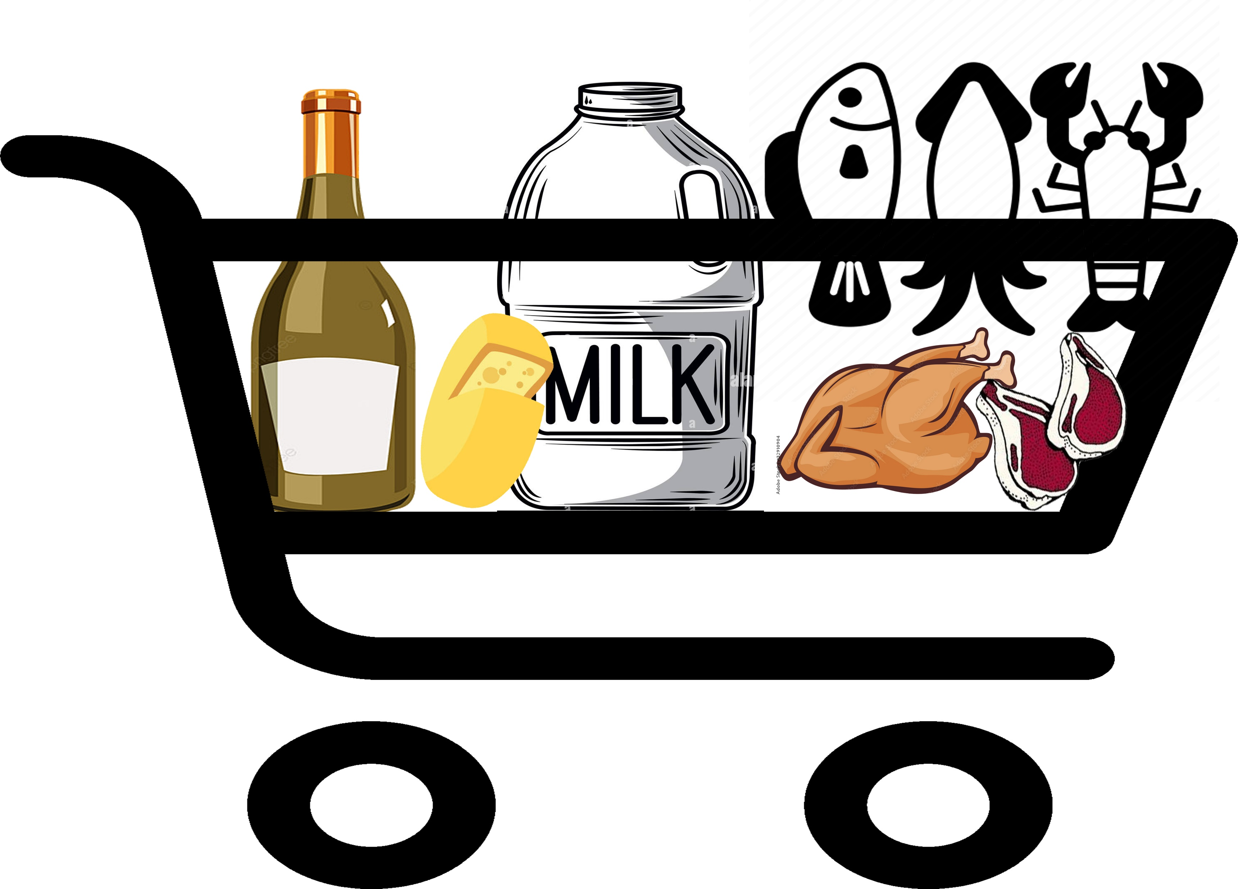
Dataset: Bureau of Labor Statistics where we analyzed 3 segments from 2013-2022:
Alcohol
Dairy & related
Meat, Poultry, Fish & Eggs

Slide 4
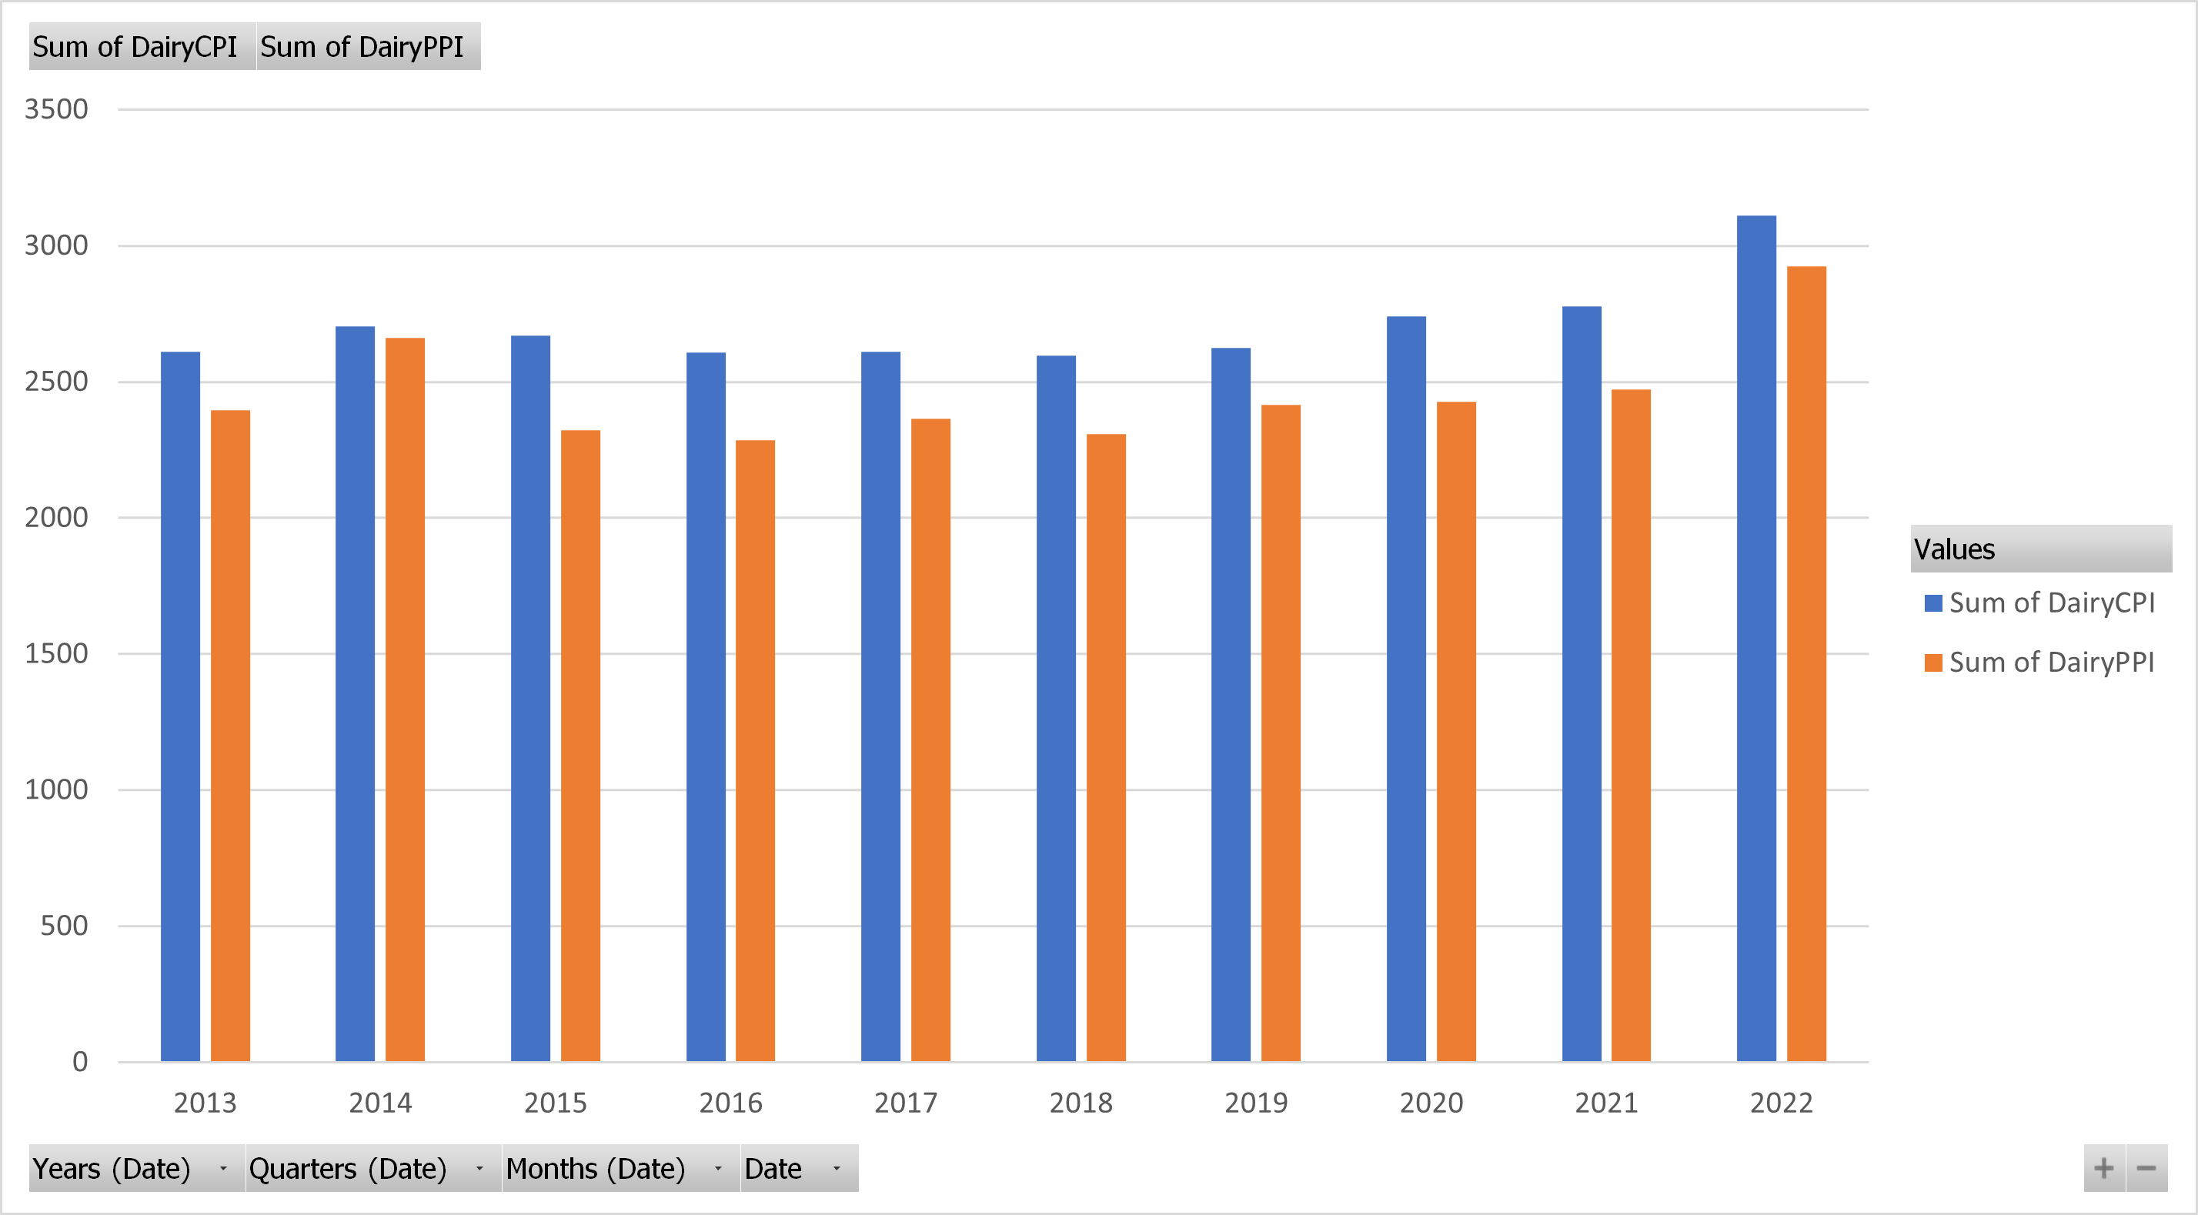
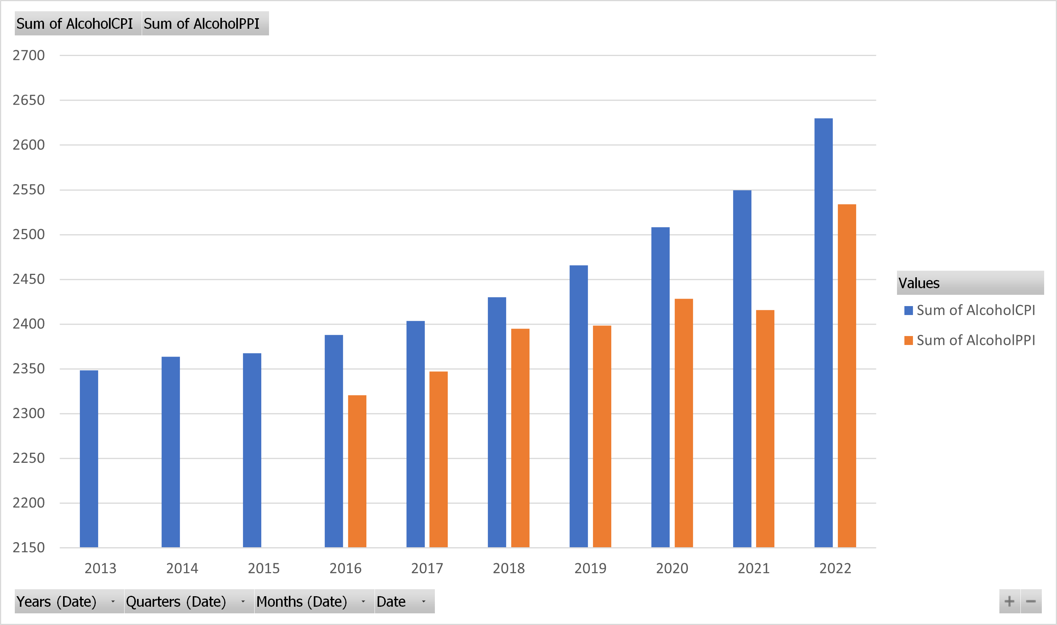
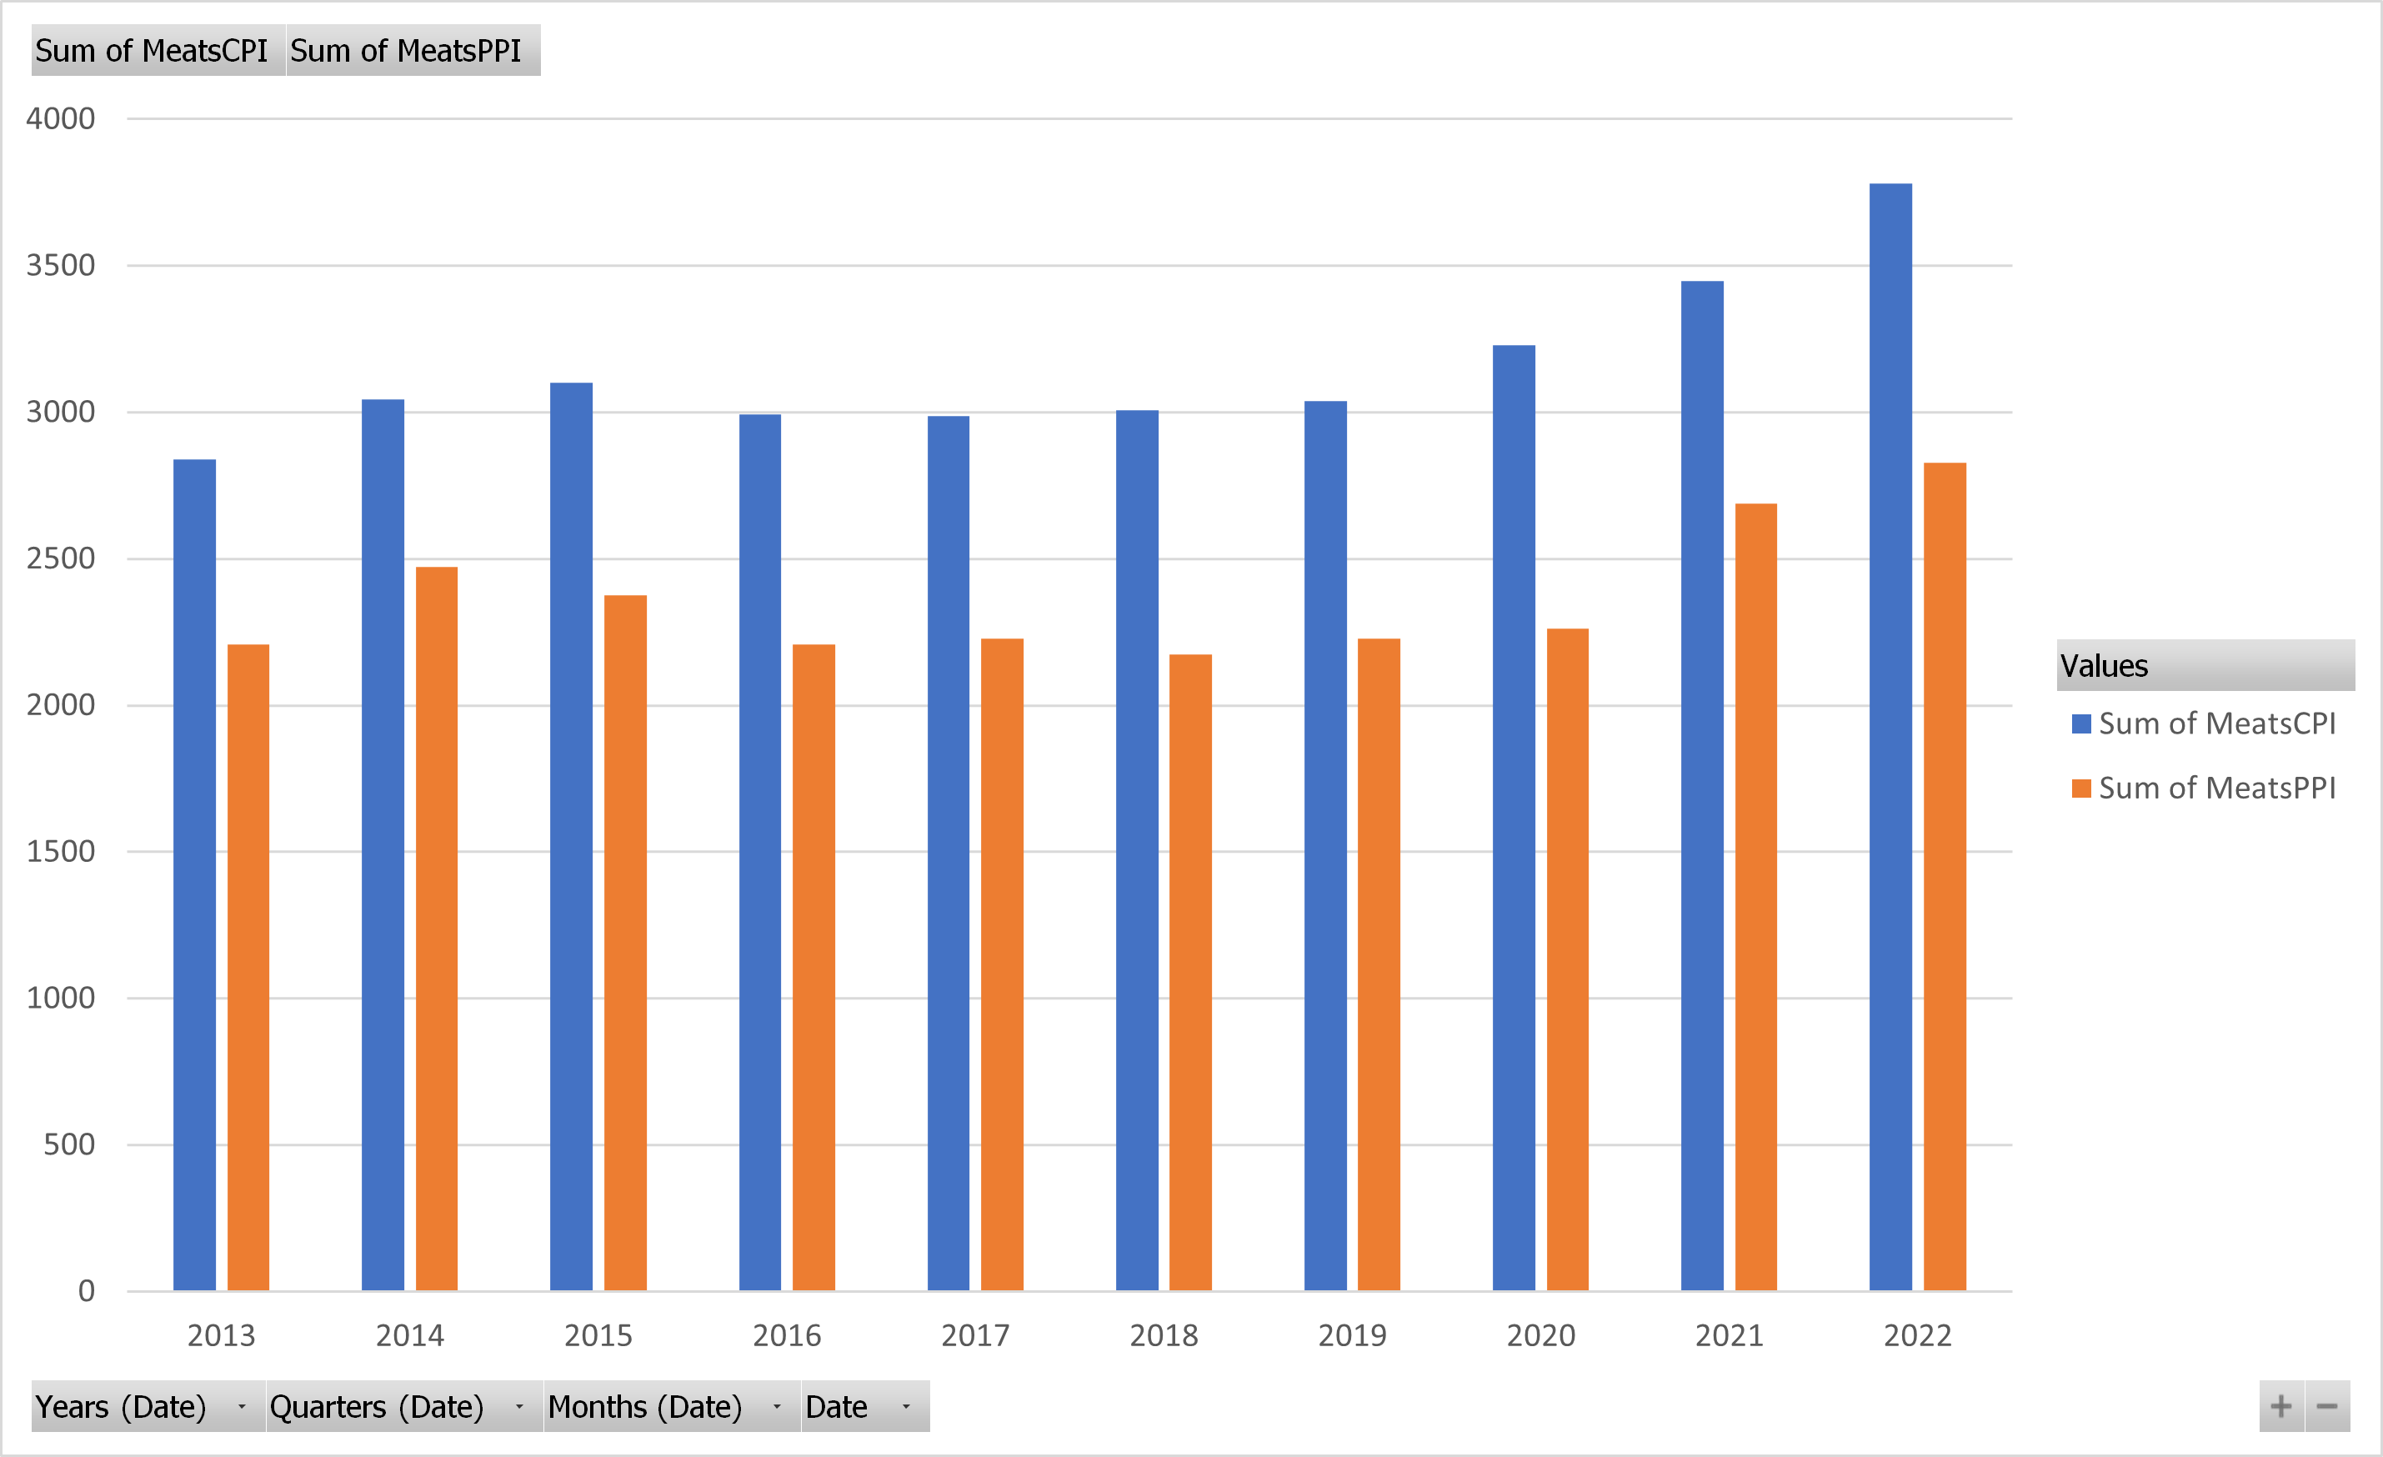
CPI vs PPI
Is it corporate greed?

Slide 5
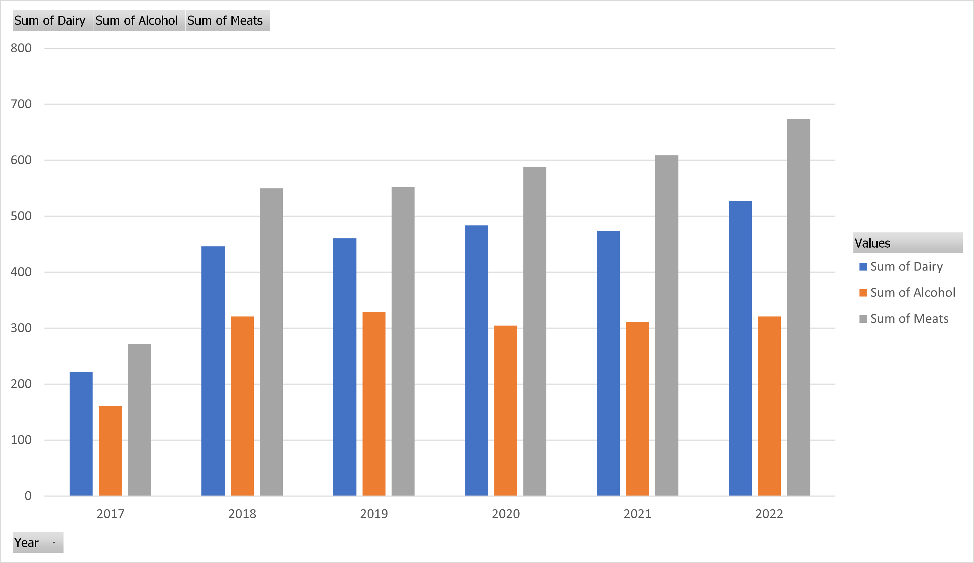


Slide 6
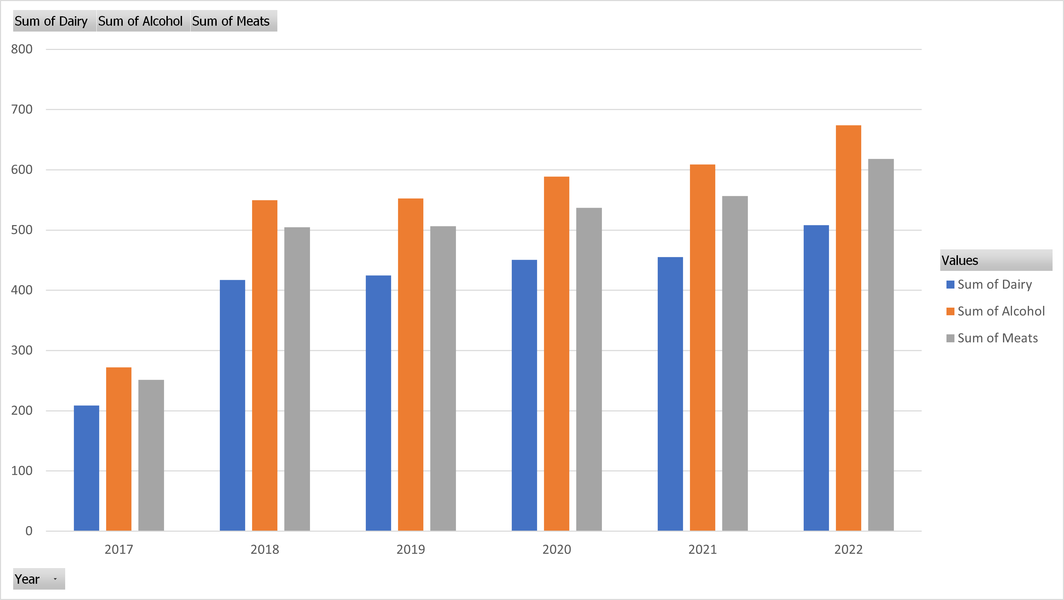


Slide 7
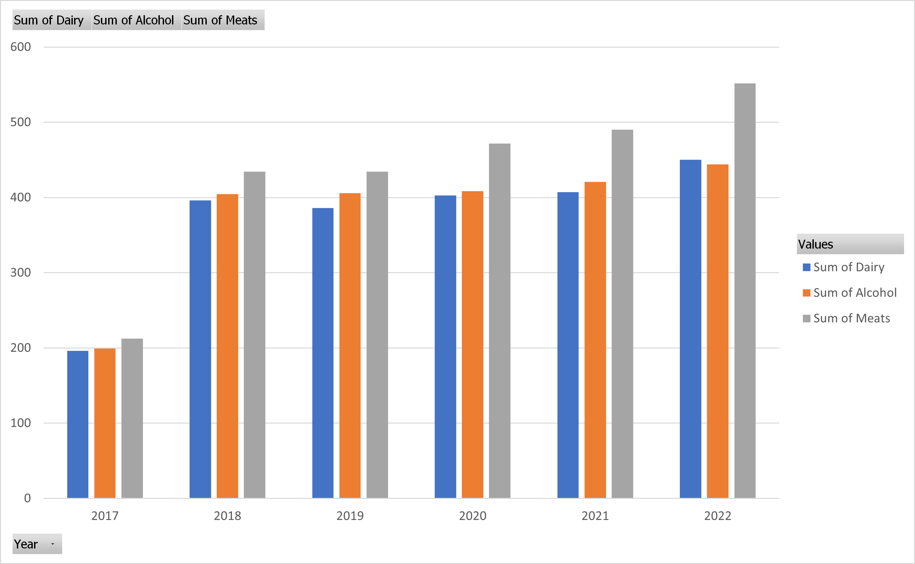


Slide 8
In summary
A generalized MASSIVE increase in prices in 2018
Meat, poultry, fish and eggs lead the dataset with the greatest increase
Generalization are difficult to make from the dataset, but it is clear that something occurred in 2017-2018 and then 2020 onward.

